Slide 1
Data Mining DS-303
Lecture 7
Muhammad Arham
Lecturer
The University of Faisalabad

Slide 2
Content
FP-Tree & Frequent Pattern Growth

Slide 3
Frequent Pattern Growth

Slide 4
What is FP Growth?
FP Growth stands for frequent Pattern growth
It is a scalable technique for mining frequent pattern in a database

Slide 5
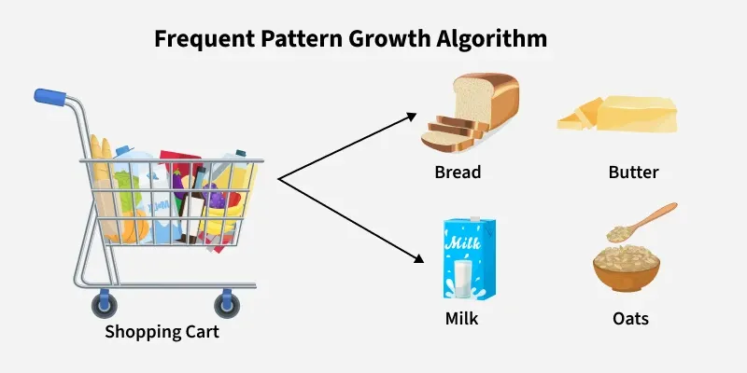
What is FP-Growth?
FP-Growth (Frequent Pattern Growth) is an algorithm that:
Mines frequent itemsets without candidate generation
Compresses database into a structure called FP-Tree
Extracts patterns directly from the tree

Slide 6
How FP-Growth Works
Here's how it works in simple terms:
Data Compression: First FP-Growth compresses the dataset into a smaller structure called the Frequent Pattern Tree (FP-Tree). This tree stores information about item sets (collections of items) and their frequencies without need to generate candidate sets like Apriori does.
Mining the Tree: The algorithm then examines this tree to identify patterns that appear frequently based on a minimum support threshold. It does this by breaking the tree down into smaller "conditional" trees for each item making the process more efficient.
Generating Patterns: Once the tree is built and analyzed the algorithm generates the frequent patterns (itemsets) and the rules that describe relationships between items

Slide 7
Key Features of FP-Growth
No candidate generation
Only two database scans
Uses divide-and-conquer strategy
Efficient for large datasets

Slide 8
FP-Tree (Frequent Pattern Tree)
An FP-Tree is:
A compact tree structure
Stores item frequency and transactions
Organizes data in prefix form
Components:
Root (null node)
Item nodes with count
Header table with node links

Slide 9
Steps of FP-Growth Algorithm
Step 1: Scan Database
Calculate support of each item
Remove infrequent items
Step 2: Construct FP-Tree
Sort items by descending frequency
Insert transactions into tree
Step 3: Mine the FP-Tree
Generate conditional pattern base
Construct conditional FP-Tree
Recursively extract frequent itemsets

Slide 10

Cont…
FP growth improves apriority to a big extent
Frequent item set Mining is possible without candidate generation
Only “Two Scan” to the database is needed
BUT HOW?

Slide 11
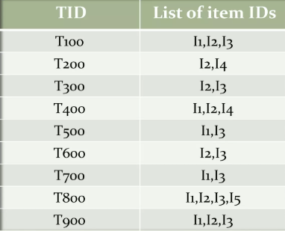
FP Growth
Simply a two step procedure
Step 1: Build a compact data structure called the FP-tree
Step 2: Extracts frequent item sets directly from the FP-tree
Now lets consider the following transaction table

Slide 12
FP-Growth
Now we will build a FP tree of that database
Item sets are considered in order of their descending value of support count.

Slide 13
FP-Tree

Slide 14
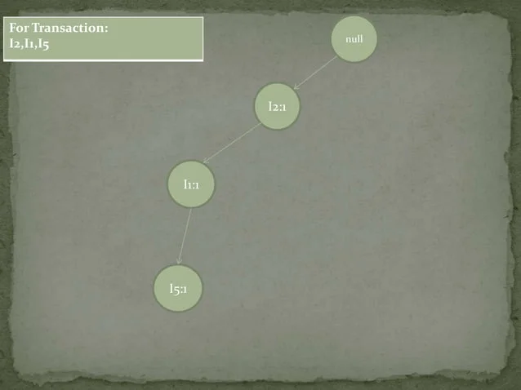

Slide 15
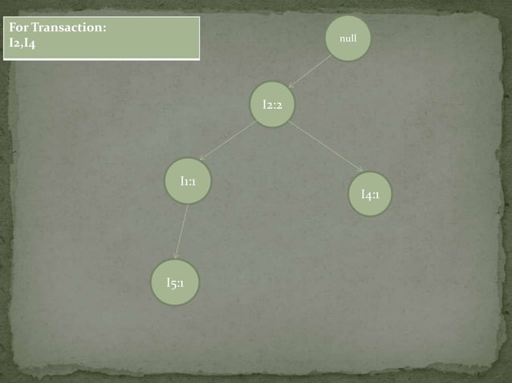

Slide 16
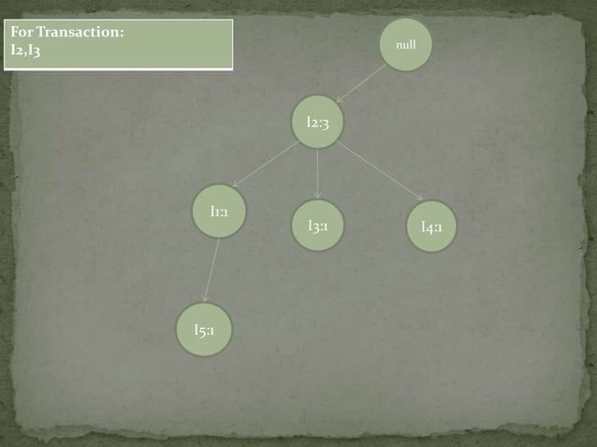

Slide 17
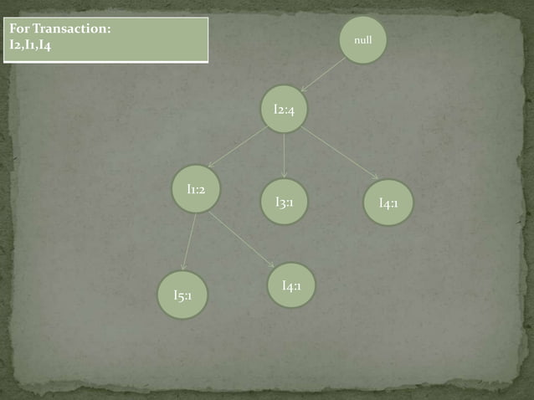

Slide 18
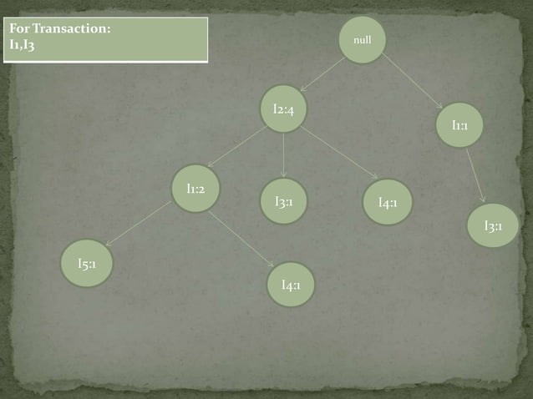

Slide 19


Slide 20


Slide 21
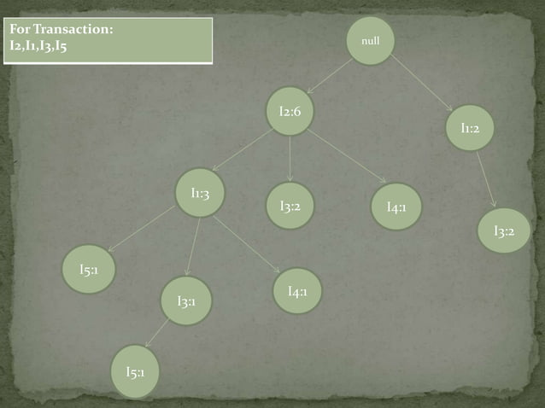

Slide 22


Slide 23
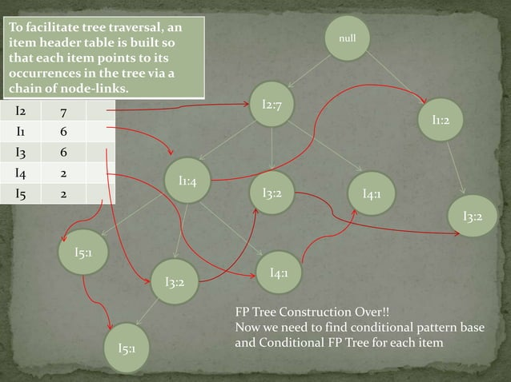

Slide 24
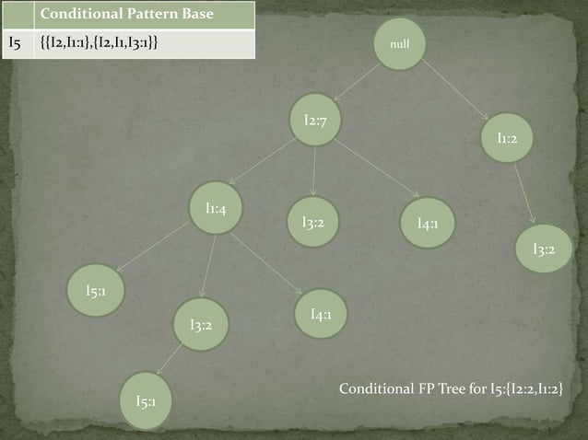

Slide 25
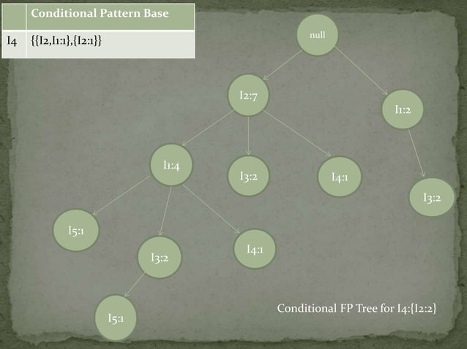

Slide 27
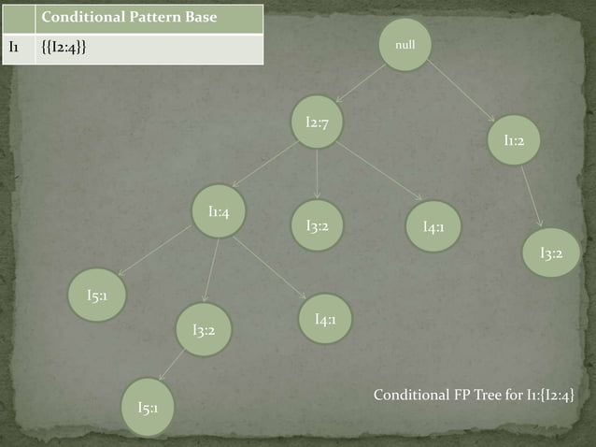

Slide 28
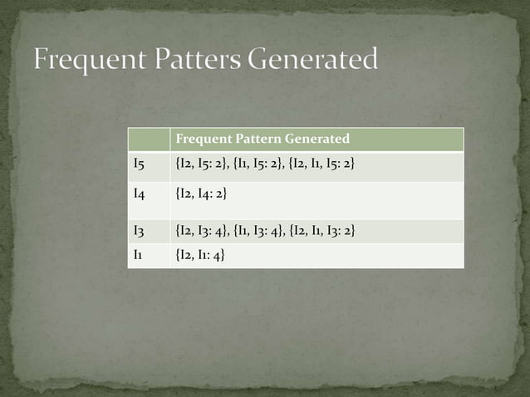

Slide 29
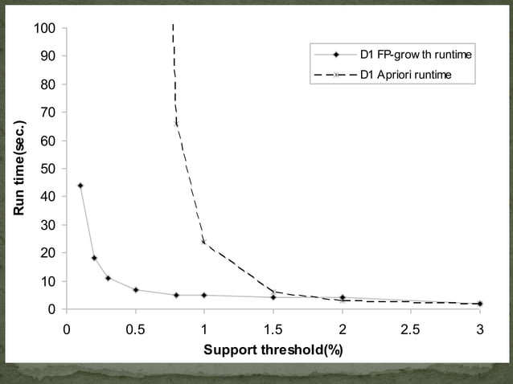

Slide 30
Applications
Market Basket Analysis
Recommendation Systems
Web Log Analysis
Bioinformatics
Fraud Detection

Slide 31
Advantages
Faster than Apriori
Handles large datasets efficiently
Reduces computational cost
Scalable and practical

Slide 32
Reference
https://www.slideshare.net/slideshow/data-mining-fp-growth/20208045#2
https://www.slideshare.net/slideshow/frequent-pattern-analysis-apriori-and-fp-growth-algorithm/267512961

Slide 33
Advice
Kindly read the book before and after the lecture, if some terms/ words are not covered in the lecture, if appear in exam it might not appear strange or out of course.

